Slide 1
Insurgent
Right to the city?
‘Urban Livelihoods’?
Notes:
This – the use of public space for LIVELIHOODS, which is the reality of public space in cities of the Southl
Not recognised in the language of planning, not easy to show on a map – no land use designation and zoning, but its importance for the livelihoods of the urban poor is immense
CONTESTED SPACE
Many colleagues have contributed to the development of ideas in this

Slide 2
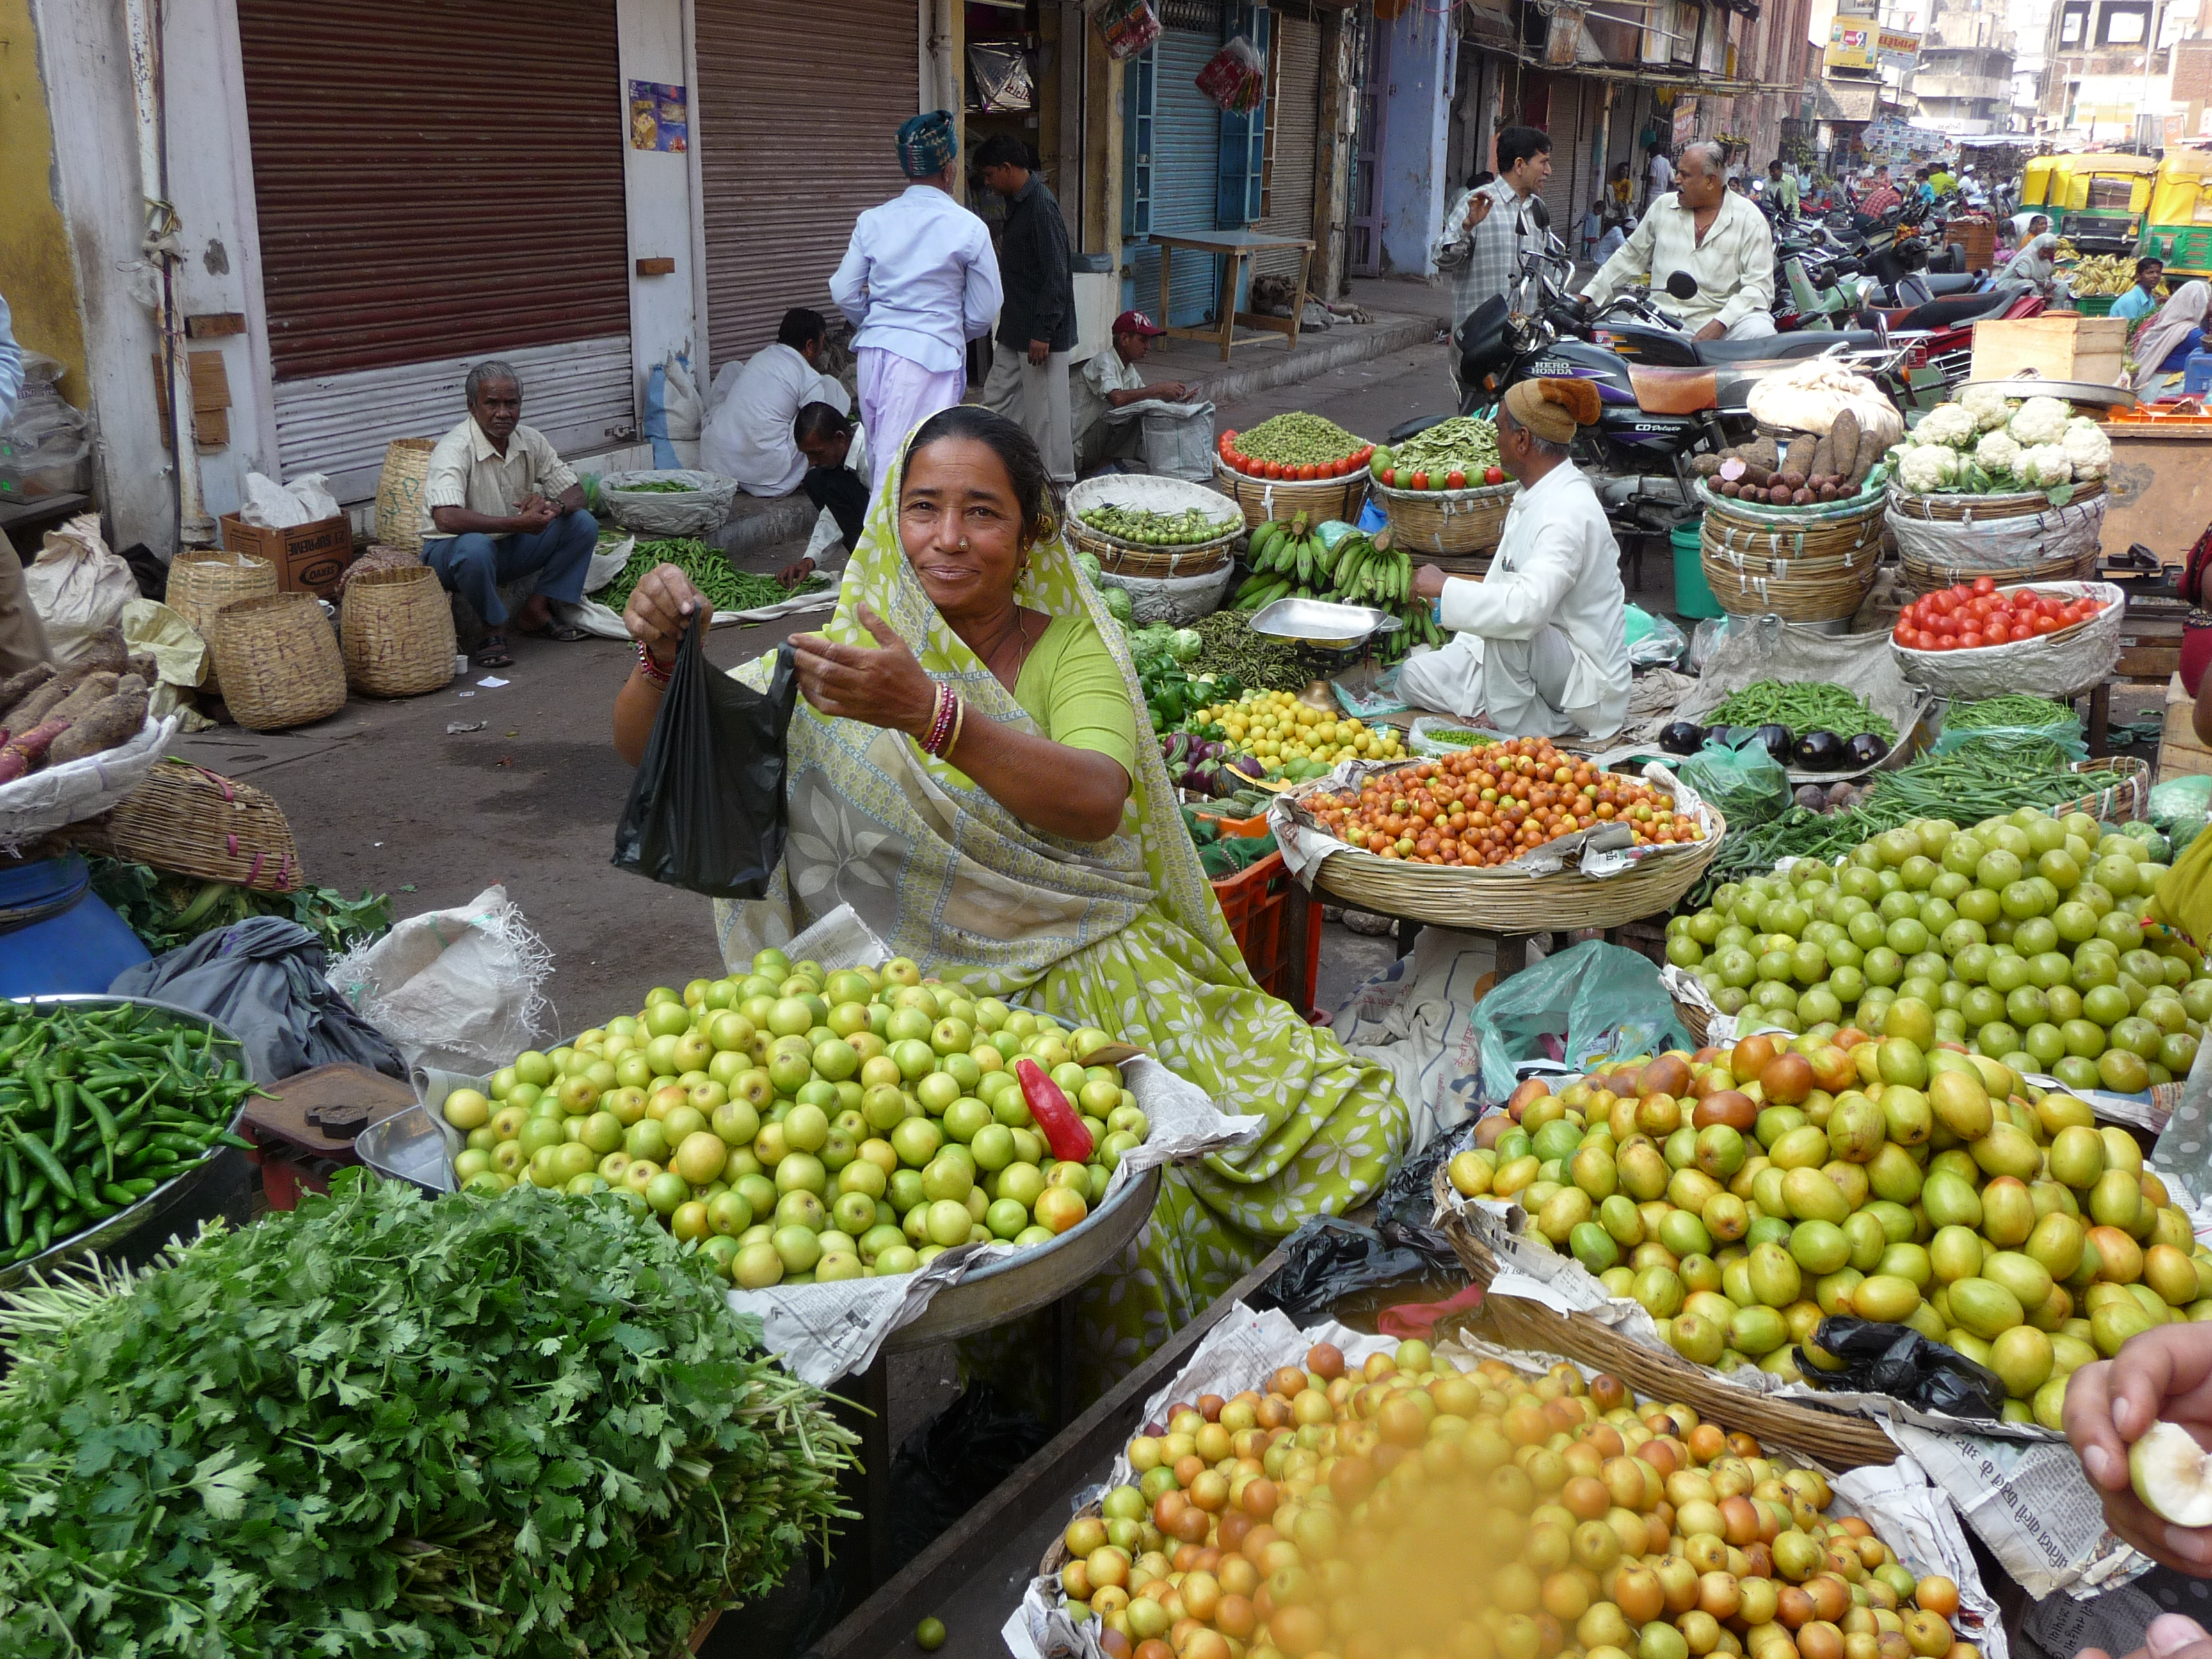

Slide 3
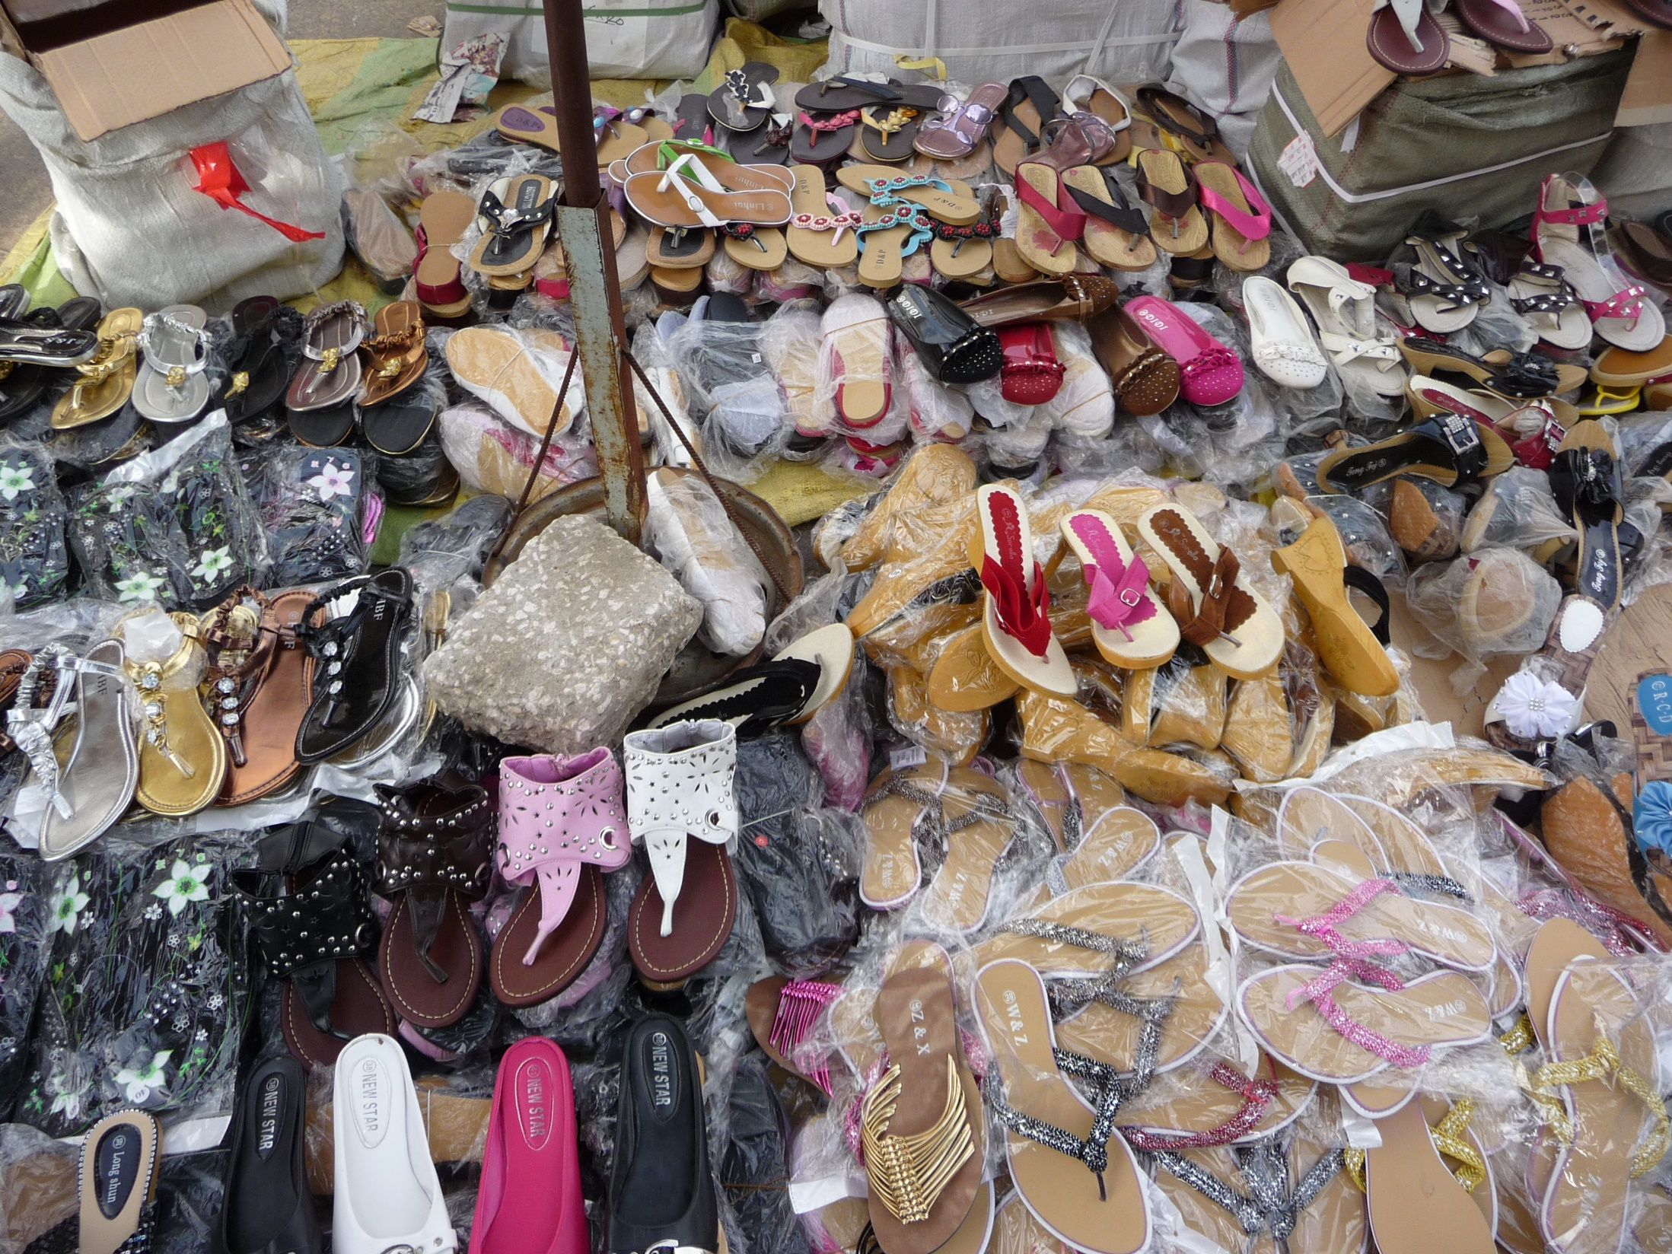

Slide 4
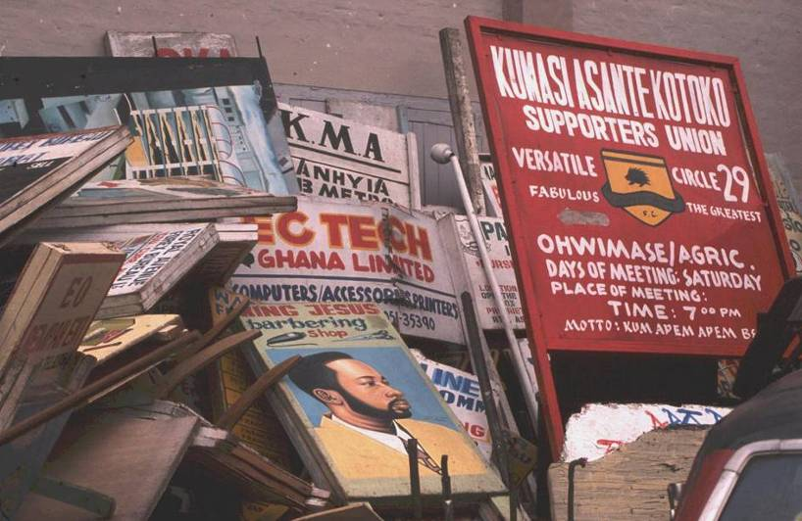
Confiscations in Ghana

Slide 5
Evictions in Kamapal - 2011
Notes:
http://www.monitor.co.ug/artsculture/Reviews/-/691232/1231744/-/8qdb9z/-/index.html
On the morning of December 17 last year, Mohammed Bouazizi, a street vendor in the Tunisian town of Sidi Bouazid, had his cart full of merchandise confiscated by his city’s authorities, because he had no vending permit. That kick-started a series of events that ended up in Mr Bouazizi setting himself on fire, and dying three weeks later in hospital.
His death stirred up a wave that took with it, presidents Ben Ali of Tunisia, Hosni Mubarak of Egypt and Muammar Gadaffi of Libya. Mohammed Bouazizi shows just how contentious the issue of street vendors and their source of livelihood can be. This week, the Kampala Capital City Authority (KCCA) has moved to clean Kampala of street vendors, to, as the city’s executive director put it, decongest the city and allow licensed traders carry out business.
The move puts the capital city at a crossroads of sorts. On one end, is a drive to modernise a scarred, dirty, third-world city while on the other, is the livelihood of over 8,000 city inhabitants and what could become of them if their fortunes took a turn for the worse after the eviction.
Struggle for survival For vendors, the eviction is an act of taking away the very plate from which they are feeding and replacing it with nothing. Mr Peter Were’s cat and mouse games with the green and yellow dressed city law enforcers have cost him a few thousand shillings in the past year. But they never convinced the dealer in shoes and belts to seek a permanent place to practice his trade.
“This year has been harder,” he says. “One time three officers caught me and took three of my pairs of shoes. I had to pay them Shs15,000 to get back my shoes. About a month after that, the same people caught me again. They asked for more because they remembered me. After begging and almost promising to give them shoes, they took Shs15,000 again,” he adds.
Why then did he stay on the streets, where he lost money worth a pair of shoes in just two brushes with the law? “Some of those people in the markets can spend a whole day without selling anything,” he says. “That is not business. At least here I see the customers, talk to them and I may even convince them to buy. In the markets, customers only come if they have decided to come and buy.” Mr Were was by Friday evening last week, still selling shoes and belts, standing outside Cham Towers on Kampala road. In there stands another problem in resettling the evicted vendors. Many do not want to go into markets. “How can they say we go to markets out of the city? Our customers are in town but they want us to go outside the city. Who will we sell to now?” says Rashid, who sold clothes on Luwum Street.
Where to next? KCCA said it had identified over 86 markets in Kampala into which the 8,000 vendors could be accommodated. These included the prime Nakawa, Nakasero and Nakivubo Park-yard markets. Vendors like Mr Were, however, said charges in the markets were too high and would eat into any profits made. The combination of rental charges in the markets and an unavailability of space could thus undermine any resettlement into those markets.
Although KCCA listed Nakivubo Park-yard market (Owino) among possible resettlement markets, there is no space for the vendors to go in there. All the slots in the market are “owned” by a network of “landlords” who booked them years ago. These landlords do not necessarily trade inside the market, Silas Kiwewa, a vendor at the market says. “They divide up their slots and then lease them out to any interested vendor. A vendor then sets up a stall in the agreed spot. They negotiate a price, which is usually about Shs70,000 per month. On top of that, vendors would then have to pay a fee to the market’s leadership of about Shs30,000,” he says.
Mr Sulaiman Lubega, the market’s chairperson, confirmed details of the ownership setting but said the monthly amount paid is Shs10,400 only and not Shs30,000.” This landlord setting squarely undoes attempts to relocate vendors into the market as there is no new space for them to walk into. Park-yard market would seem to be the ideal relocation for the vendors, most of whom traded in down-town Kampala. But its crowdedness closes out an alternative located right near to where their former business base was.
KCCA spokesperson, Mr Simon Muhumuza, says the list of markets which included Park-yard is an old one and that in a newer list, the market had been scrapped off.
At Nakawa market, the chairperson, Paddy Sentamu, said his market had space to accommodate between 300 and 500 extra vendors but only on the bare ground and not in the stalls, which are filled up. The charges at Nakawa are also divided into rental charges to KCCA and to landlords for stalls and shops. According to the market’s secretary, Baguma Rugumayo, it costs between Shs30,000 and Shs70,000 to rent a stall. On top of that, one would have to pay Shs9,100 to KCCA.
Call for caution There is concern for the potential outcomes of the eviction if it is mishandled. Dr Faisal Buyinza from Makerere University’s (MUK) School of Economics, says KCCA should have gone slow. There is likelihood that crime could go high because people will have lost their source of living, he says. “KCCA should have first studied and surveyed the vendors’ contribution; they play a very big part in informal employment and create a lot of tax revenue,” he says.
The issue of potential crime is one raised even by the vendors themselves. “The reason we are not pick-pocketing on the streets is because we have this simple work to do. If this is also taken away, don’t be surprised if there is an increase in the rate of crime,” says Mr Were. Mr Charles Omagor, dean at the Faculty of Commerce in Makerere University Business School (MUBS) acknowledged the need to create order in the city, but noted, there ought to be a sound back up plan of where to take the vendors.
“The eviction is long overdue. We want order but where the vendors are supposed to be taken should be there. If there’s no place for the vendors to be taken, they (KCCA) should go slow. Most get their livelihood from there (markets.) It’s a case of either having food on the table or no food on the table,” says Mr Omagor. Dr Buyinza added that vendors would shun any suggested resettlement places if they would not be able to do business there.
The MUBS don also said the eviction could have an effect on pricing as the vendors had been helping neutralise prices offered by traders in shops. With the vendors gone therefore, shops would have no external competitor to hold back their prices.

Slide 7
Making Legal Space for the Poor:
An Evaluation Toolkit
Brown A. R2C 121114A

Slide 8
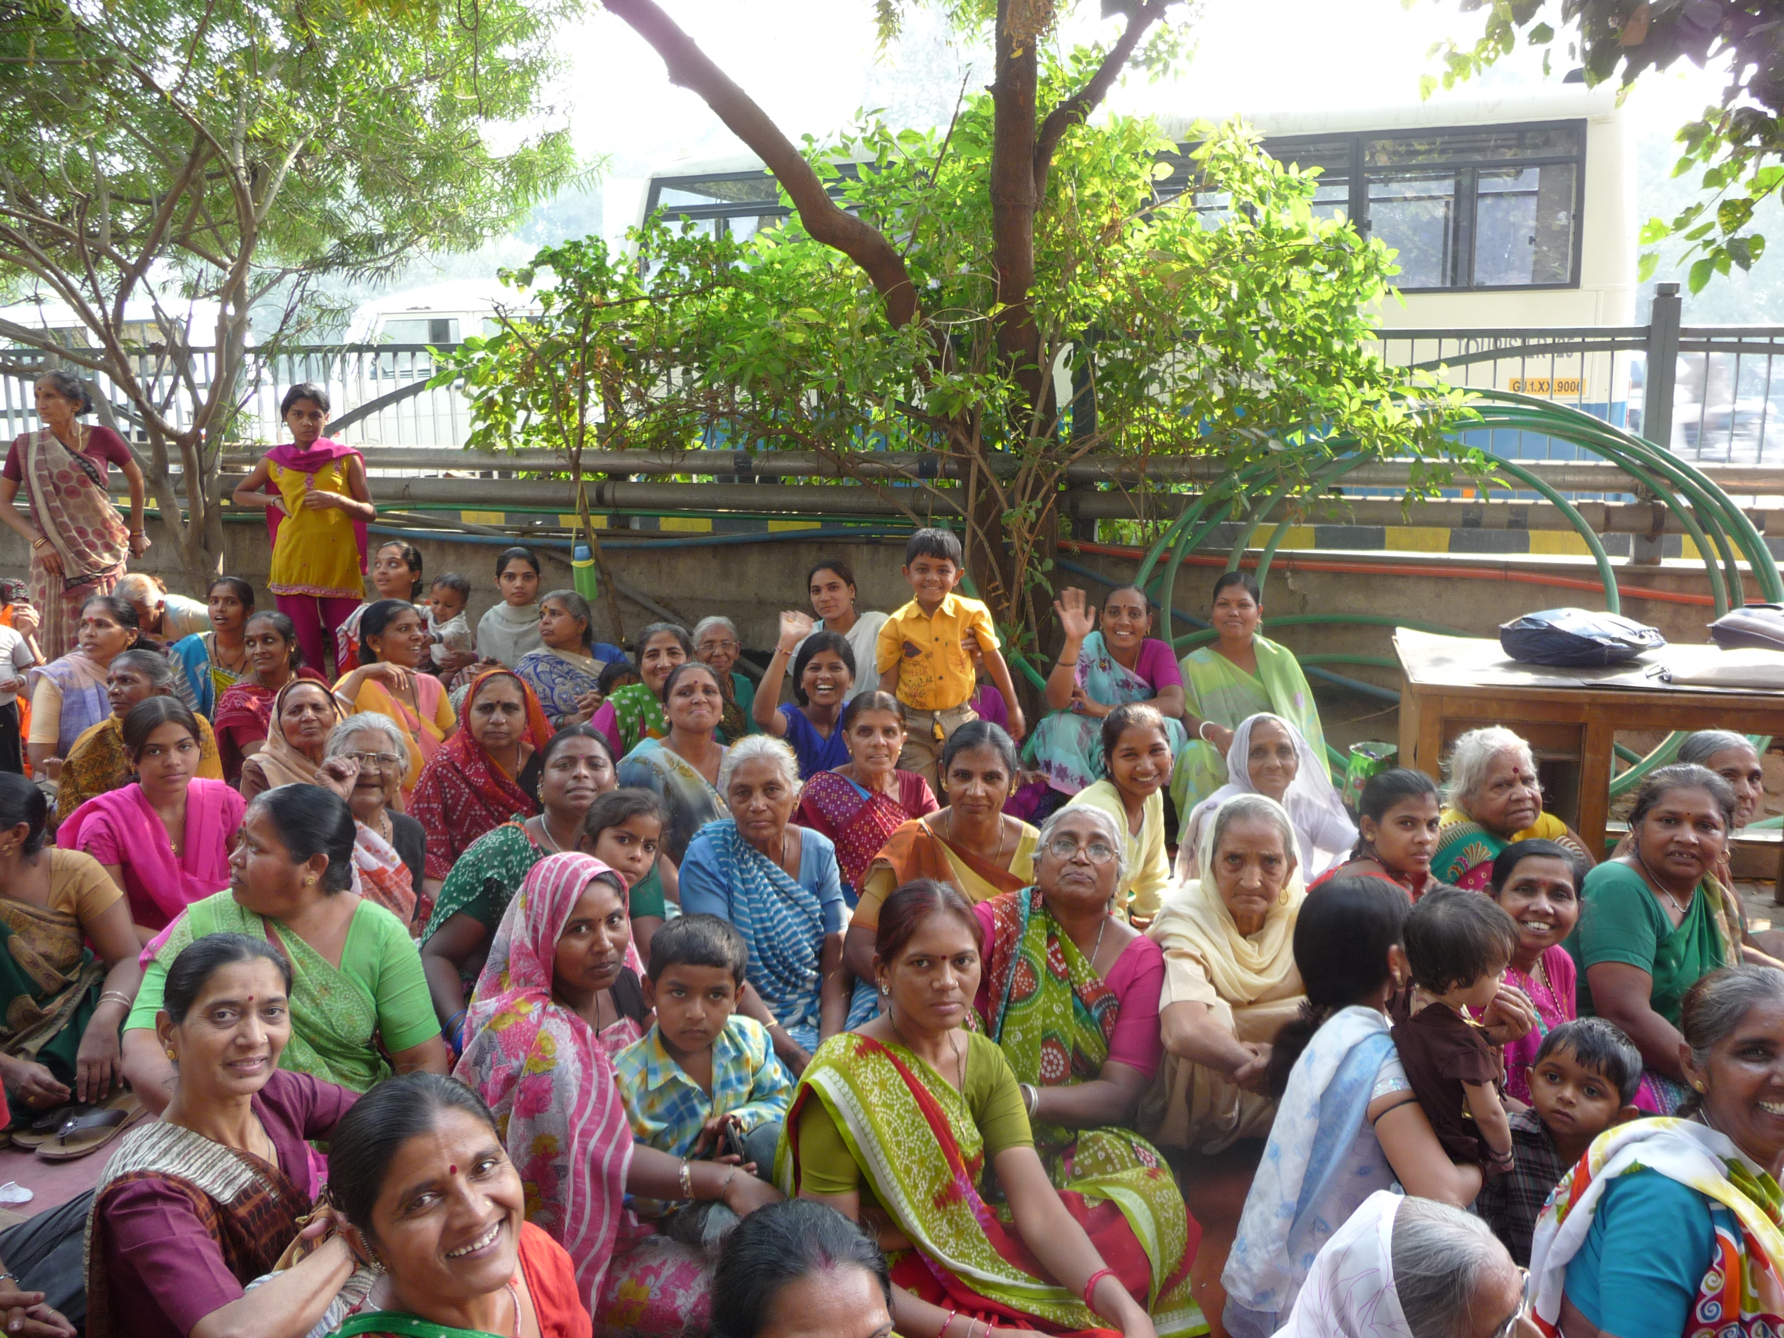
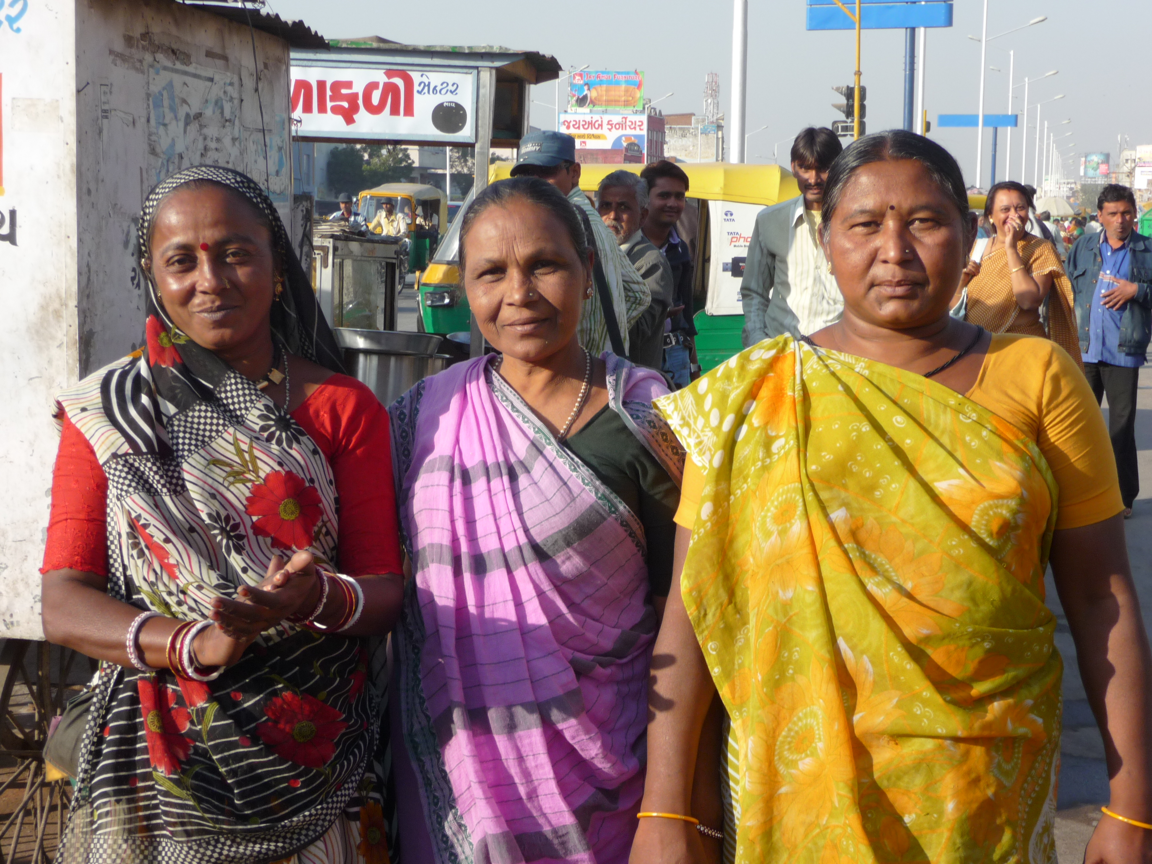

Slide 9
Durban Street Traders – saved a market from redevelopment 2014
Notes:
http://www.inclusivecities.org/wp-content/uploads/2012/07/Dobson_Success_Story_Saving_Mother_Market.pdf,
http://wiego.org/informal_economy_law/street-vendors-and-law

Slide 10
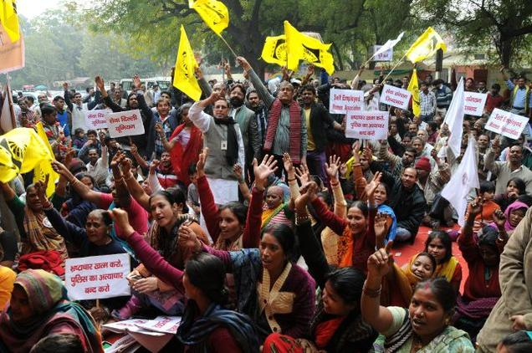
National Association of Street Vendors of India – celebrate new Bill - 2014
Notes:
http://www.thehindu.com/news/national/street-vendors-bill-passed-in-rajya-sabha/article5706501.ece
Members of the National Association of Street Vendors of India (NASVI) staging a protest and indefinite hunger strike to seek support for passage of the Street Vendors Bill in Rajya Sabha, at Jantar Mantar, in New Delhi on Wednesday. The House passed the bill, which aimed at creating "conducive" atmosphere for street vendors and designated spaces for them to carry out their business. Photo: Shanker Chakravarty
Bill that provides for protection of livelihoods rights, social security of street vendors and for regulation of urban street vending in the country--the Street Vendors (Protection of Livelihood and Regulation of Street Vending) Bill, 2014--was passed in the Rajya Sabha on Wednesday.
Moving the Bill for consideration and Passing in the House, Minister of Housing and Urban Poverty Alleviation Girija Vyass said street vendors constitute an integral part of the urban economy and not only a source of self-employment to the poor in cities and towns but also a means to provide affordable as well as convenient services to the urban population.
The Provisions of the Bill are aimed at creating "conducive" atmosphere for street vendors, and designated spaces for them to carry out their business.
The Bill provides for constitution of a Town Vending Authority in each Local Authority, which is the fulcrum of the Bill, for implementing the provisions of the Bill, survey of all existing street vendors, and subsequent survey at-least once in every five years, and issue of certificate of vending to all the street vendors identified in the survey, with preference to SC, ST, OBC, women, persons with disabilities and minorities.
All existing street vendors, identified in the survey, will be accommodated in the vending zones subject to a norm conforming to 2.5 per cent of the population of the ward or zone or town or city and where the number of street vendors identified are more than the holding capacity of the vending zone, the Town Vending Committee (TVC) is required to carry out a draw of lots for issuing the certificate of vending for that vending zone and the remaining persons will be accommodated in any adjoining vending zone to avoid relocation.
The Bill also provides guidelines that will have to be followed for the relocation, eviction and confiscation of goods and establishment of an independent dispute redressal mechanism under the chairmanship of retired judicial officers to maintain impartiality towards grievance redressal of street vendors.
To safeguard vendors against excesses by the Police, Section 29 of the Bill provides for protection of street vendors from harassment by police and other authorities and provides for an overriding clause to ensure they carry on their business without the fear of harassment by the authorities under any other law.

