Slide 1
Right to the City and Sustainable Development Goals – Post 2015 Agenda
International Meeting on the Right to the City
São Paulo, Brazil
November 13, 2014
Jane Katz
Government Relations and Advocacy
Habitat for Humanity International

Slide 2
Overview
Post 2015/SDG’s
Road Map to Habitat III
World Urban Campaign
Civil Society Organization Engagement
Notes:
CSO engagement in the global agenda

Slide 3
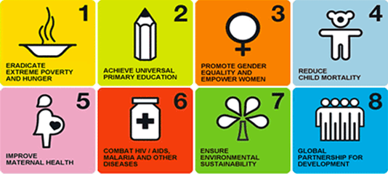
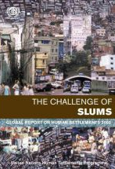
Notes:
You just heard from Maruxa on the process of getting to the SDGs.
Habitat for Humanity was primarily concerned with Goal 7, Target 11 of the current MDGs which calls for improving the lives of 100 million slum dwellers, a challenge which has only grown since 2000.
With a myriad of interests shaping the next MDGs, a strong voice for shelter is essential. Habitat for Humanity has tried to leverage its global network to ensure shelter is sufficiently represented in the next Millennium Development Goals.
In this presentation, I’m going to focus my remarks on the linkages of the SDG and Habitat III -- the creation of the New Urban Agenda
And the participation and engagement of cso’s in influencing the urban agenda.

Slide 4
Housing and the Post-2015 Agenda
Habitat for Humanity believes housing needs to be prominently featured in the Post-2015 Development Agenda
Notes:
Habitat for Humanity ‘s engagement in the Post 2015 process began with the need to make sure that housing (and slums ) were addressed in the Post 2015 Agenda.

Slide 5
HFH Actions on Post-2015 Agenda
CEO Sign-On letter from 10 INGO’s to Secretary General about the next MDG’s
50 HFH National Offices signed letter to UN MDG Special Advisor pushing a housing focus
HFHI White Paper: Elevating Housing in the “next MDG’s”
Guidance given to HFHI Global Network on process and engagement in country consultations
Coordinating advocacy in the U.S. with National NGO Platform and the International Housing Coalition
Notes:
Habitat has tried to leverage its global network to ensure shelter is sufficiently represented in the next Millennium Development Goals.

Slide 6
HFHI Engagement in Post-2015 SDGs
Communitas Coalition
International Housing Coalition
Cities Alliance
World Urban Campaign
InterAction
Notes:
Expand on WUC later.

Slide 7
Goal 11:
Make cities and human settlements inclusive, safe, resilient and sustainable
Notes:
What emerged from all of the work on the Post 2015 – was a Proposed Cities Goal – Target 11.1 – by 2030 ensure access for all to adequate, safe, and affordable housing and basic services, and upgrade slums

Slide 8
Linking SDGs and the Urban Agenda
Notes:
Habitat III, which will be held in 2016, is the third conference hosted by the United Nations on Housing and Sustainable Urban Development. The purpose of Habitat III is to reinvigorate the global commitment to sustainable urbanization with the focus of producing and implementing a “New Urban Agenda” through a multi-sector approach. The “New Urban Agenda” will define urban priorities for the following 20 years. The conference will result in a concise, focused, forward-looking and action-oriented outcome document.
Habitat III is expected to bring together cities, governments, civil society, the private sector, education institutions, and interest groups to review urban housing policies in the context of an increasingly urban world. Habitat III will be the first UN global summit after the adoption of the Post-2015 Sustainable Development Agenda and, hopefully, a new climate change agreement. It offers a unique opportunity to discuss the important challenge of how cities, towns and villages are planned and managed, in order to fulfill their role as drivers of sustainable development, and hence shape the implementation of new global development and climate change goals.

Slide 9
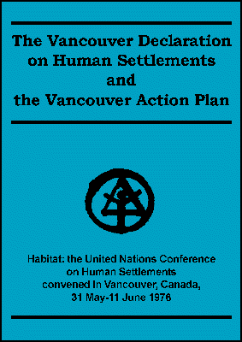
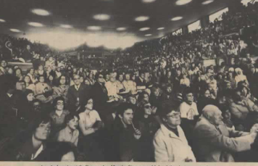
https://www.youtube.com/watch?v=gNDGGb8F6Jk&index=9&list=PLC420AEA764137222
Notes:
The first Conference on Housing and Sustainable Development (Habitat I) was held in 1976 in Vancouver, Canada. At the time of Habitat I, governments were just beginning to witness and feel the consequences of rapid urbanization, especially in the developing world. In this climate, a collective recognition for sustainable human settlements developed. As a result of Habitat I, the United Nations created the UN Human Settlements Programme (UN-Habitat).
Habitat Forum (People’s Forum) Participants: Barbara Ward, Margaret Mead, Paolo Soleri , Mother Theresa, Buckminster Fuller ; 136 Member states passed the Declaration (uncontrolled urbanization and inequitable econo ic growth must be offset by the adoption of bold, meaningful and effective humans settlement policies and spatial planning strategies -- 64 recommendations followed

Slide 10
2002 Direct subsidiary of General Assembly
Notes:
After 15 years of working with the declaration that emerged from Habitat II, the UN General Assembly decided in 2011 to hold the Habitat III conference in 2016, twenty years after Habitat II. United Nations Secretary-General Mr. Ban Ki-moon appointed UN-Habitat's Executive Director, Dr. Joan Clos, Secretary-General for Habitat III and to act as focal point on behalf of the United Nations system. Habitat III’s theme will be to renew the “global commitment to sustainable cities.”

Slide 11
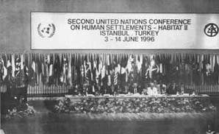
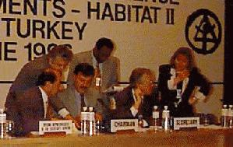
Notes:
Twenty years later in 1996, Habitat II was held in Istanbul, Turkey as a recommitment to human settlements. Habitat II marked the first time that urbanization and growing cities were regarded as engines of growth that would potentially offer great opportunities to the people.
The creation of Cities alliance was an outgrowth of Habitat II –
Habitat for Humanity passed a resolution endorsing the Right to Housing

Slide 12
Origin and Development of World Urban Campaign
Notes:
Launched in 2010 by UN Ha bitat as a way to engage partners in a focus on cities including best practices, policies and tools and advocacy. Members were from a variety of sectors – public, private, ngos, social, academia, city orgs – cities alliance, UCLG, Metropolis, trade unions and women’s networks. 100 cities campaign

Slide 13
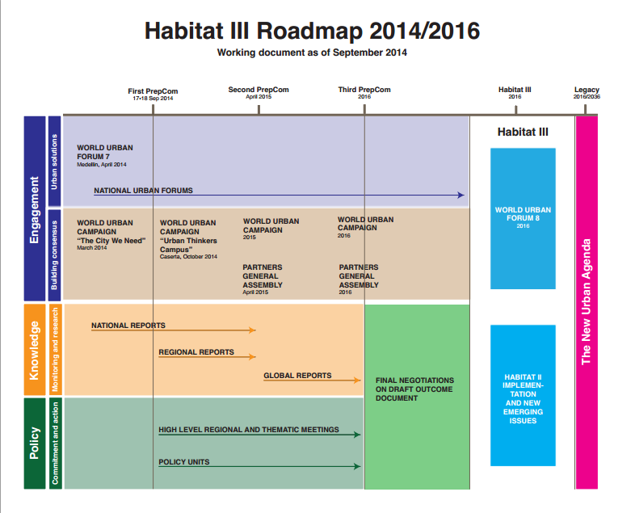
Notes:
Road Map to Habitat III
UN-Habitat has been engaging stakeholders in process leading up to Habitat-III through a variety of channels. Below is a diagram showing the Roadmap to Habitat III, featuring key dates, events, and processes. The second preparatory committee meeting (PrepCom 2) will be held in April, 2015 in Nairobi, Kenya.

Slide 14
World Urban Forum 7 - Medellin
Civil Society Organization Roundtable
Report of CSO conclusions to Plenary
Medellin Declaration
Notes:
Habitat for Humanity helped to coordinate the Civil Society Roundtable Civil Society Roundtable: A new Urban Agenda responsive to the people’s priorities for an equitable urban future
and providing critical input into the Medellin Declaration, the outcome document leading to Habitat III. With our partners – with the help of HIC – Lorena, Nelson, SDI – Rose; and others we contributed conclusions to the Plenary –
Ensure civil society and communities are officially part of the process;
Access to land and tenure as critical to “Right to the City”
Empower communities to partner as equals with sectors
Engage women in the planning and implementation
WUF 7 Medellin Declaration: “Promote sustainable urban development, based on urban planning that promotes youth participation, gender equality, balanced territorial development; strengthened resilience to climate change and natural disasters; the upgrading and prevention of slums; and provision of housing, basic services and land tenure security; access to safe, affordable, accessible, and sustainable transport; and access to safe public spaces and services for all.”

Slide 15
Habitat III
HFH Housing Forums
World Urban Campaign
Post- 2015 Advocacy
National, Regional and Global Reports
U.N. PrepCom Mtgs
National Committees
Cities Alliance
Communitas
Notes:
Lots of moving pieces – spaces for debate , participation

Slide 16
Preparatory Committee I
Statement of Habitat for Humanity to General Assembly
Habitat III Civil society Working Group
Consultations
Side Events

Slide 17
WUC Working Group on Habitat III
Mobilizing a large number of partners to increase global,
national and local awareness of key urban issues through
messaging and communication activities;
Supporting national campaigns to formulate key messages and gather
solutions to urban challenges for Habitat III;
Building knowledge and consensus towards the contents of a New Urban Agenda
through an inclusive participatory mechanism for all Habitat Agenda Partners
that identifies useful local and national level policies, practices and legislation

Slide 18
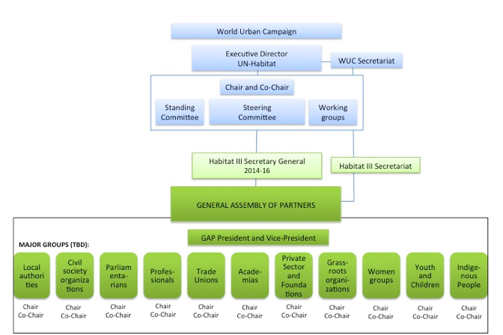
DRAFT PROPOSAL TO BE SUBMITTED TO HABITAT III SECRETARY GENERAL
NOTE: PARTNER CONSTITUENCY GROUPS , LABELED MAJOR GROUPS BELOW, UNDER DISCUSSION BUT WILL REPRESENT NINE
MAJOR GROUPS DEFIINED BY AGENDA 21, HABITAT AGENDA PARTNERS AND OTHER RELEVANT STAKEHOLDERS.
ANTICIPATES SEVERAL MEETINGS PRIOR TO HABITAT III TO BE HELD IN DIFFERENT REGIONS AT CRITICAL JUNCTURES e.g. PrepCom2,
after passage of the SDGs and so forth.

Slide 19
Actions and Next Steps
Expand Civil Society Organizations participation
Elect a co-chair for the WUC Global Platform
Engage/Influence National Committees and Country Reports
What else?

Slide 20
Putting Housing and Human Settlements on The Global Agenda
Thanks!
Jane Katz (jkatz@habitat.org)
Government Relations and Advocacy
Habitat for Humanity International

Slide 22
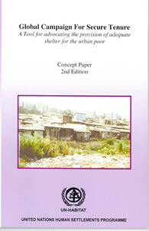
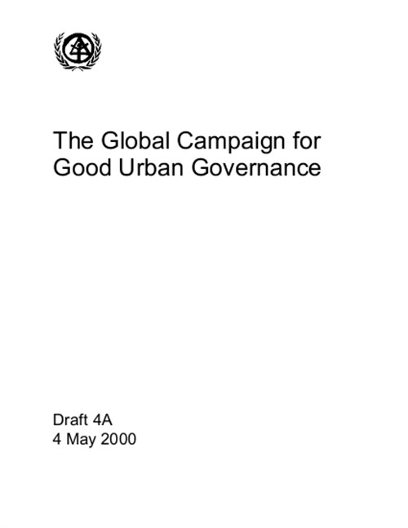
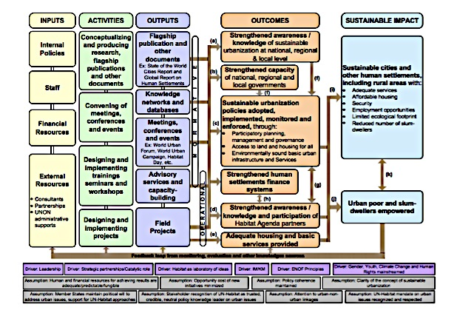
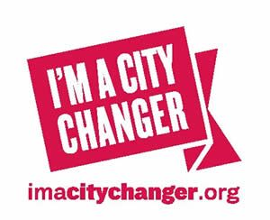
History of UN-Habitat and Partners Engagement

Slide 23
Paris Principles
World Urban Campaign Purposes
UNITE STAKEHOLDERS
ENABLE TOOLS
MEASURE DATA
CONNECT POLICY
World Urban Campaign Functions
KNOWLEDGE CREATION
CONSENSUS BUILDING
ADVOCACY

Slide 24
2000
MDGs
2012
Slum Target "met"
Sept. 2014
Open Working Group Report
Sept. 2015
MDGs Expire SDGs Enacted
2016
Habitat III
Road to Habitat III The Sustainable Development Goals and Habitat III, two separate but related United Nations processes, provide excellent opportunities to shape policy and discourse around global development. Habitat for Humanity will continue to develop recommendations, mobilize support and leverage its network to influence these important events.
Final plan, the “Sustainable Development Goals,” to be approved by United Nations
U.N. conference focused on cities and human settlements will create a “new urban agenda” and hopefully implement SDG cities goal
70 country U.N. taskforce recommends a new framework including housing target as part of a broader goal on sustainable cities
More than 100 million slum dwellers’ lives have improved, but the challenge is growing
8 Goals, 18 Targets, 48 Indicators create an innovative global framework to end poverty by 2015

