Slide 1
The Right to the City:
Its Concept and Implementation
In Gwangju, South Korea
Nov, 13, 2014
SHIN Gyonggu
Director, Gwangju International Center
Professor Emeritus, Chonnam National University
Notes:
세계와 연대할 준비가 돼 있는가?

Slide 2
Outline
Context: South Korea
Context: Gwangju City
Gwangju as a HR City Implementation of the Principle
Gwangju International Center Vision of a Human Rights City

Slide 3
South Korea & Human Rights

Slide 4
S. Korea Country Facts: World Bank
Population: 48,754,657 (July 2011 est.)
Area: 99,720 sq. km.
Ethnic groups: Korean (99%)
Languages: Korean, English taught
Religions: (1995 census) Buddhist 23.2% Protestant 19.7% Catholic 6.6% Others 1.3% None 49.3%
Literacy: 97.9% (2002)
Urbanization: 83% (2010)
Access to Improved Water Sources: 100% (2009)

Slide 5
S. Korea and Gwangju Map

Slide 6
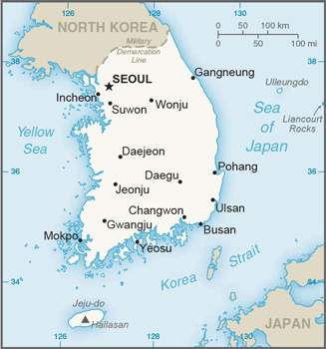
Gwangju Facts
330Km South of Seoul
1.5 million
City of Light (translation)
Kia motors producing 600,000 cars/year Kumho Tyres Samsung, LG

Slide 7
Rebel City
1929 Student Independence Movement: 1 of the 2 major uprisings for independence
1980 May Uprising: one of 2 major uprisings for democracy
Progressive party’s strong hold - Kim Daejung (1998-2003)’s power base - 90% to the candidates of democrats

Slide 8
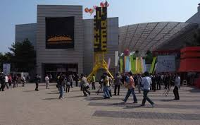
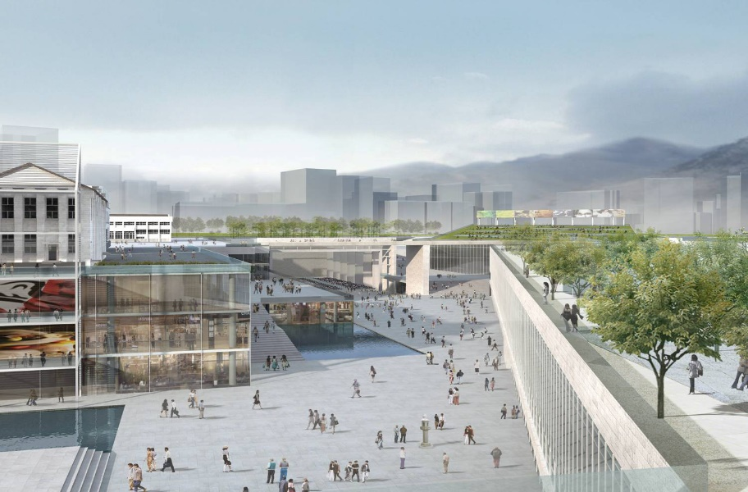
Culture City
Asia Cultural Complex constructed by central government with $4 billion
Gwangju Biennale is one of the five major Art Biennale

Slide 9
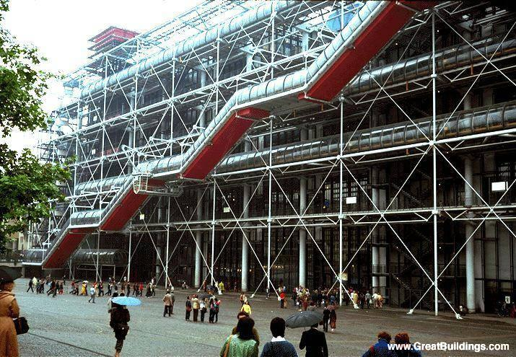
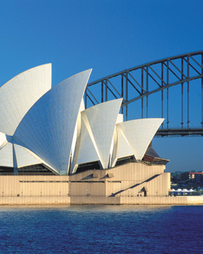
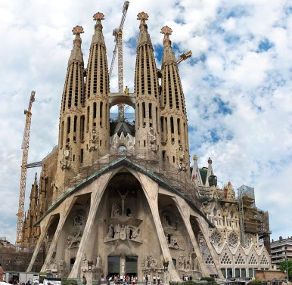
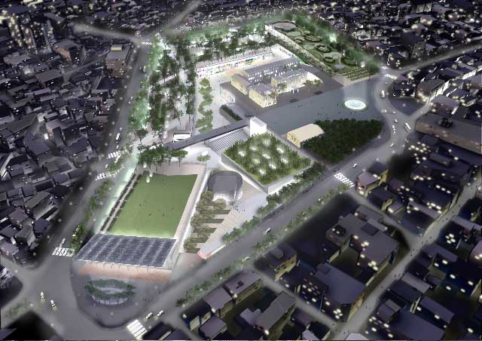
Asia Culture Complex in Comparison
Name | Georges Pompidou | Sydney Opera House | Barcelona Sagrada Família | Gwangju Asia Culture Complex
Period | 1971 - 1977 | 1957 - 1973 | 1883 - 2026 | 2004 - 2015
Cost $ | 100,000,000 | 70,000,000 | 2,860,000,000 | 700,000,000
Visitors | 3 million | 1.2 million | 2.5 million | ?
Population | 2.3 million | 4.4 million | 1.6 million | 1.5 million
Notes:
파리의 퐁피두. 공장건물, 연간방문 3백만, 파리인구1천2백만, 파리관광객 2천7백만
시드니오페라. 예술공간, 비용
사그라다 파밀리아. 147년, 비용. 26억$, 연간방문2.5백만, 인구
광주 문화전당: 총비용 4조, 단일건물+문화산업지원, 문화센터5개원, 도시7개권 개발

Slide 10
Local Autonomy and Human R
1949 Local autonomy law established
1961 Local autonomy law abolished after coup
1980 May Uprising: HR on the streets
1987 New democratic constitution
1991 Local autonomy law re-established
1995 City mayors and provincial governors by election
2001 National Human Rights Committee established

Slide 11
Gwangju as a Human Rights City

Slide 12
Guiding Principles of HR
Principle 1: The Right to the City • The HR City respects all HR recognized by the existing relevant international HR norms and standards. • The HR City recognizes and implement the right to the city in line with the principles of social justice, equity, solidarity, democracy and sustainability.
Principle 2: Non-Discrimination and Affirmative Action: Gender-sensitive policies, affirmative action to empower the vulnerable groups such migrants & non-citizens.
Principle 3: Social Inclusion and Cultural Diversity
Principle 4: Participatory Democracy and Accountable Governance
Principle 5: Social Justice, Solidarity and Sustainability
Principle 6: Political Leadership and Institutionalization
Principle 7: HR Mainstreaming
Principle 8: Effective Institutions and Policy Coordination
Principle 9: HR Education and Training
Principle 10: Right to Remedy

Slide 13
Implementation in systems
2007 Gwangju City’s HR Ordinance
2010: Seoul City’s HR Ordinance
2010: Followed by other cities 8/18 high level local governments
20/227 low level local governments
World Human Rights Cities Forum 2011
2012 Gwangju HR Charter
2013
2014 Guiding Principles of HR
2015 Human Rights Cities for All

Slide 14
Implementation: HR Index
5 HR Areas
Democratic Participation
Happy Life
Social Inclusion
Environment & Safety
Creativity & Solidarity
100 HR Indices

Slide 15
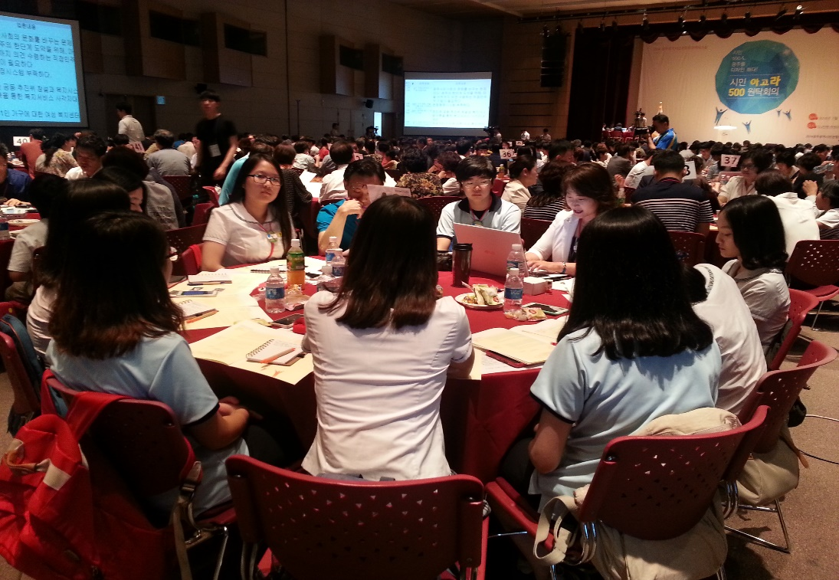
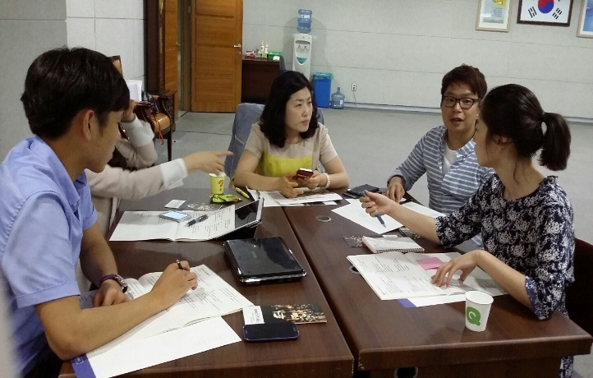
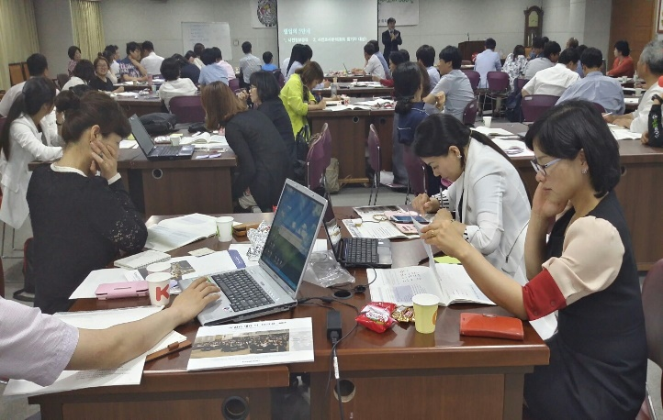
Implementation: People’s Council
Citizen’s agora, which began in 2001, chosen as a national model of a citizen participation in 2014

Slide 16
Implementation: May 18 Foundation
Established by Citizens
Changed into government organization
Asia Forum
Gwangju Peace Prize includes Aung San Sukki

Slide 17
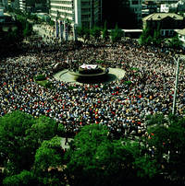
UNESCO MOW Register in 2011
Human Rights Documentary Heritage 1980 Archives for the May 18th Democratic Uprising against Military Regime, in Gwangju, Republic of Korea

Slide 18
Gwangju International Center

Slide 19
Implementation: Gwangju International Center
NPO with 3 international out of 15 full-timers
Fee paying member: 1,000
Annual expenditure: $500,000 City Hall support: 16%
Foreigners participation - Membership fee - Volunteer serviceS

Slide 20
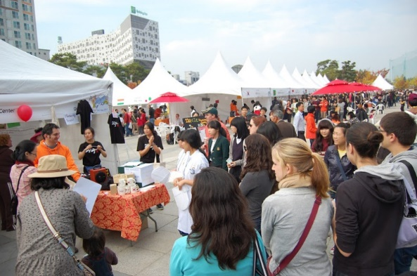
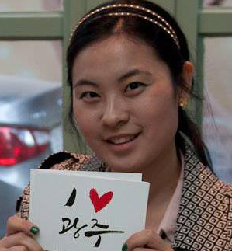
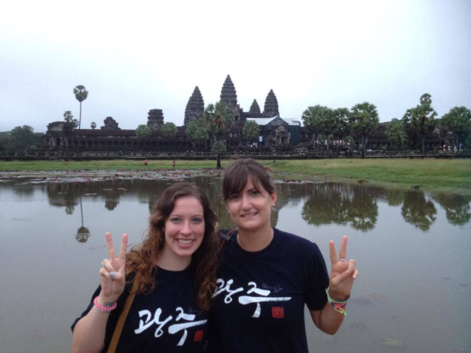
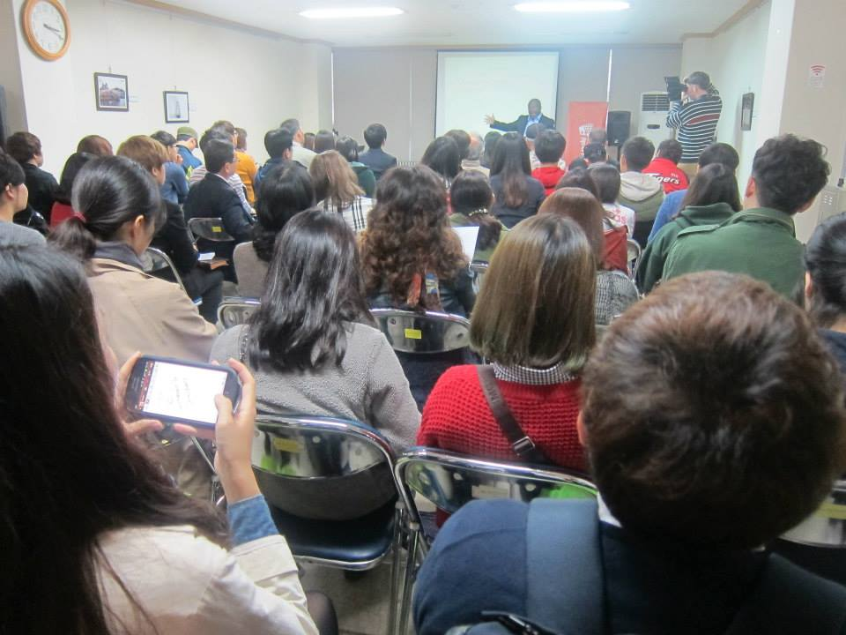
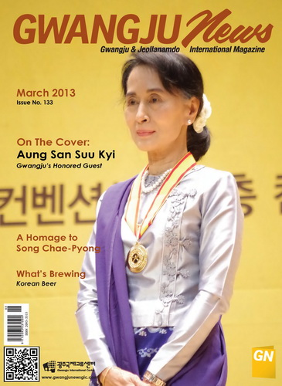
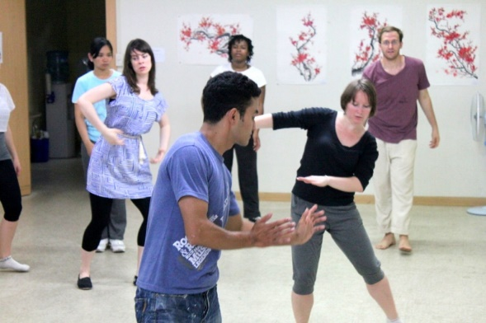
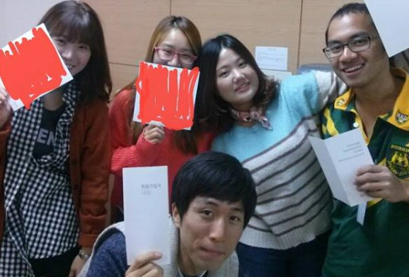
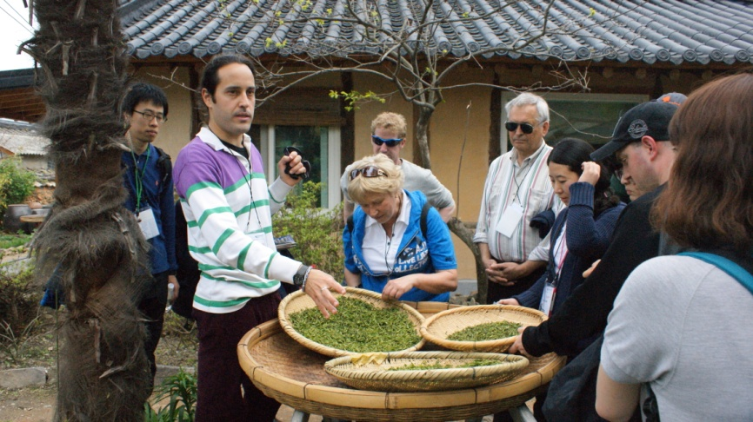
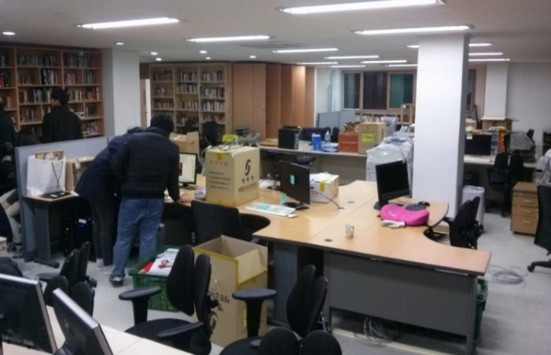
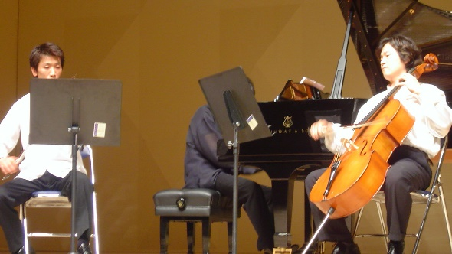
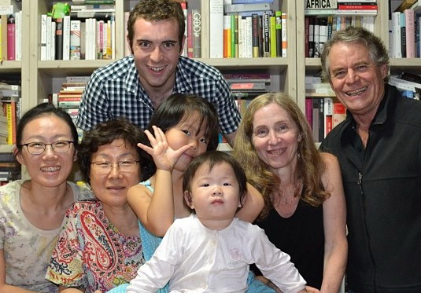

Slide 21
Visions of Gwangju As a Human Rights City
Raising the awareness of HR among younger generation in low intensity activism
Learning from precedents of other parts of the world
Promoting the network of - Human Rights Cities in Korea - Human Rights Cities in Asia

